Slide 1
Designing a Blockchain-Driven eVault System for Legal Document Preservation
CSE7301 University Project
Review-3
Batch Number: CSE_ISR_CAP_08
Roll Number | Student Name
Under the Supervision of,
Dr. Praveena K N
Associate Professor – Senior Scale
School of Computer Science & Engineering
Presidency University
ROLL Number | Student Name
20211ISR0034 | MADHUBALA S
20211ISR0045 | B KRIPASHINI

Slide 2
Introduction
In today’s digital era, securing and managing legal records is a critical challenge due to risks like unauthorized access, data tampering, and document forgery. Traditional storage systems, whether paper-based or digital databases, are vulnerable to breaches, loss, and inefficiencies.
This project focuses on developing a Blockchain-Based eVault designed specifically for storing, verifying, and managing legal records in a secure and immutable manner. By leveraging blockchain’s key features—decentralization, cryptographic security, smart contracts, and transparency—the proposed system ensures that legal documents remain authentic and verifiable throughout their lifecycle.

Slide 3
Literature Review
Blockchain for Secure Document Storage
Nakamoto (2008) introduced blockchain as a decentralized ledger, ensuring data integrity without relying on central authorities. Swan (2015) emphasized blockchain’s ability to provide an auditable and transparent record of transactions, making it ideal for legal document management.
Smart Contracts for Legal Records Verification
Smart contracts, introduced by Szabo (1997), automate contract execution based on predefined conditions, eliminating intermediaries. Research by Buterin (2014) on Ethereum’s smart contract capabilities demonstrates how legal documents can be verified and executed automatically upon meeting legal conditions.
Additionally, Karamitsos et al. (2018) propose a blockchain-based legal document system where smart contracts enable automated legal compliance, digital notarization, and dispute resolution.

Slide 4
Decentralized Storage for Legal Documents
Benet (2014) introduced IPFS, which provides content-based addressing, ensuring legal records remain verifiable without being stored directly on the blockchain.
Gupta et al. (2020) highlight how a hybrid approach (storing document hashes on-chain and files in decentralized storage) ensures both data integrity and efficient storage management.
Challenges and Limitations
Research by Lin & Liao (2020) indicates that blockchain networks like Ethereum experience high transaction costs and slow processing speeds during peak usage. Moreover, legal and regulatory frameworks must evolve to support blockchain-based document authentication.

Slide 5
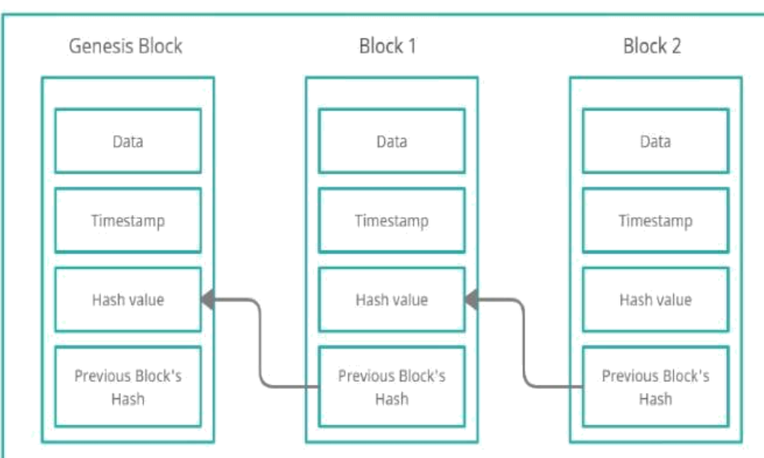
Proposed Method
System Architecture
Blockchain (Ethereum/Hyperledger) is used for recording document metadata (hashes, timestamps, ownership).
Smart Contracts automate access control, authentication, and verification.
InterPlanetary File System (IPFS) or Filecoin is used for storing actual legal documents efficiently.
2. Architecture Components
User Interface (Web/Mobile App) – Enables users (lawyers, government officials, individuals) to upload, verify, and access legal records.

Slide 6
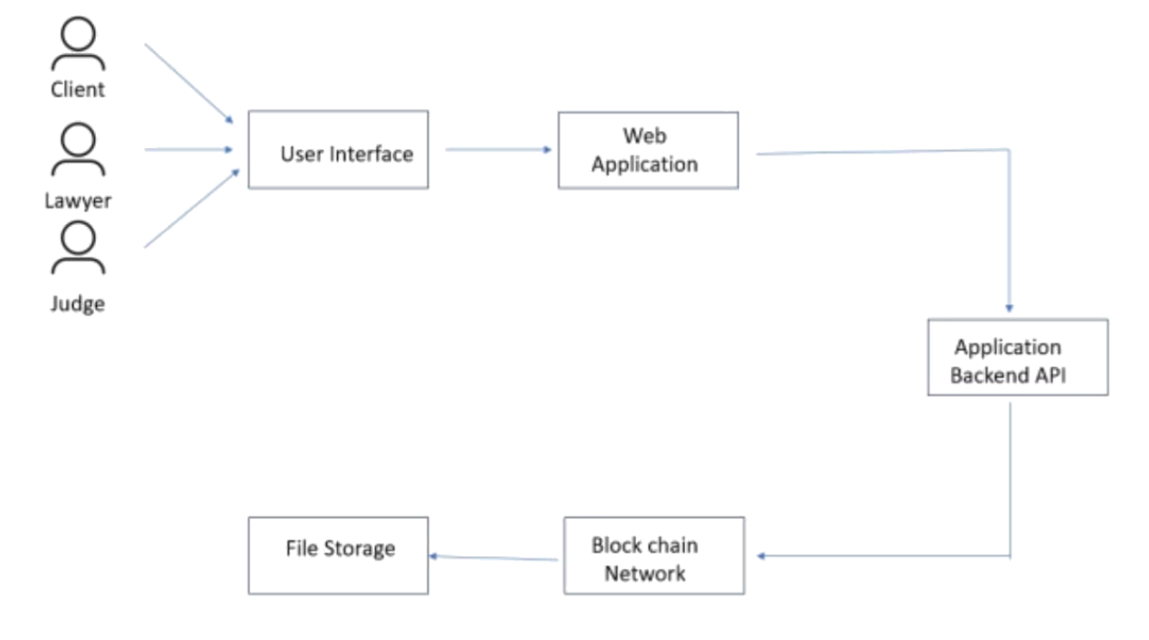
PROPOSED SYSTEM
Blockchain Layer – Stores document hashes and transaction history for immutability.
Smart Contract Layer – Manages user authentication, permissions, and document verification.
Decentralized Storage (IPFS/Filecoin) – Ensures scalable, secure file storage.
Access Control Module – Uses public-private key encryption for secure document retrieval.
3. Security Features
Immutability: Prevents unauthorized tampering with legal records.
Data Encryption: Ensures privacy during document storage and transmission

Slide 7
Objectives
To develop a secure and tamper-proof eVault using blockchain technology for storing and managing legal records.
To ensure data integrity and authenticity by utilizing cryptographic hashing and decentralized ledger technology.
To integrate decentralized storage (IPFS/Filecoin) for scalable and efficient document management.
To reduce dependency on centralized authorities and eliminate risks associated with single points of failure in traditional legal document storage.
To improve accessibility and transparency by providing a decentralized, permission-based system for stakeholders (lawyers, courts, individuals).

Slide 8
Methodology
Requirement Analysis
Identify the legal document storage challenges
Define user roles
Determine security and compliance requirements
System Design
Blockchain Layer for transaction immutability.
Decentralized Storage (IPFS/Filecoin) for document storage.
Blockchain & Smart Contract Development
Blockchain Integration:
Use SHA-256 hashing to store document fingerprints on the blockchain.
Smart Contract Development:
Develop smart contracts for user authentication, access control, and legal verification

Slide 9
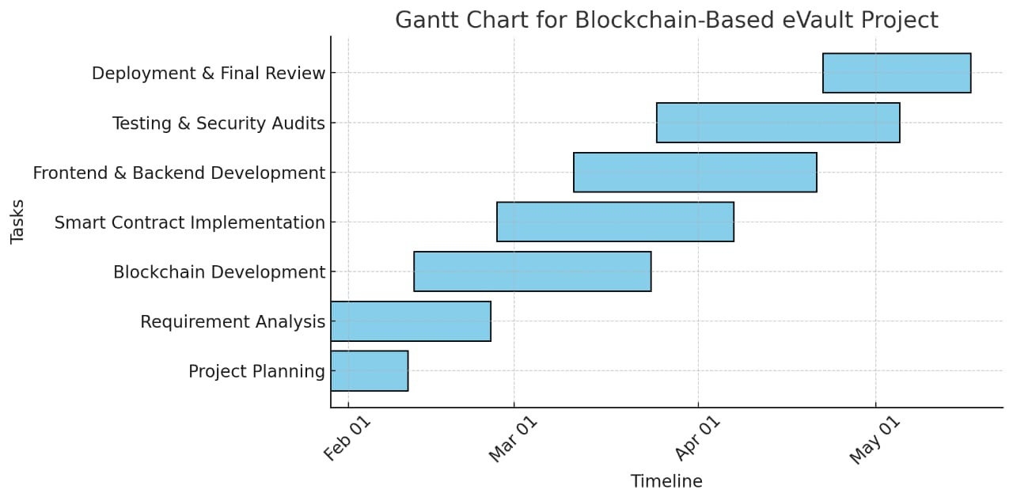
Timeline of Project

Slide 10
ALGORITHM
File Encryption Algorithm
Uses AES (Advanced Encryption Standard) for symmetric encryption and RSA (Rivest-Shamir-Adleman) for asymmetric encryption to secure file content.
Employs SHA-256 for generating file checksums to ensure data integrity.
2. Consensus and Data Management Algorithm
Blockchain consensus is achieved using Proof-of-Work (PoW) or Proof-of-Stake (PoS), depending on the selected blockchain platform.
Merkle Trees are utilized for efficient data verification and integrity checks.
3. . File Chunking Algorithm
Files are divided into smaller chunks before encryption to improve storage and retrieval efficiency.
Uses Rabin's fingerprinting algorithm to determine chunk boundaries dynamically.

Slide 11
Process of Uploading Documents to a Blockchain Network
File Selection: Users choose documents to upload via a file input window.
Metadata Extraction: The system processes the selected files and extracts relevant metadata.
Hashing and Storage:
Documents are hashed to create a unique identifier.
The hash and metadata are stored on the blockchain for verification.
Digital Signing:
Users sign documents using private keys and digital signatures to verify authenticity.
The digital signature ensures the sender’s identity without revealing document content.
Audit Logging:
The entire document exchange is recorded on the blockchain.
Audit logs ensure traceability and security, preventing data breaches or tampering.

Slide 12
Expected Outcomes
Enhanced Security & Immutability
Legal records will be tamper-proof and secure due to blockchain’s immutable nature.
Decentralized & Transparent Storage
A transparent audit trail will be maintained for legal verification and compliance.
Automated Legal Verification
Smart contracts will automate document verification, reducing dependency on intermediaries such as notaries.
Improved Legal Record Management
Role-based access (lawyers, courts, individuals) will ensure documents are accessible only to authorized users.
Regulatory Compliance & Auditability
Reduces time & costs associated with manual record-keeping and verification.

Slide 13
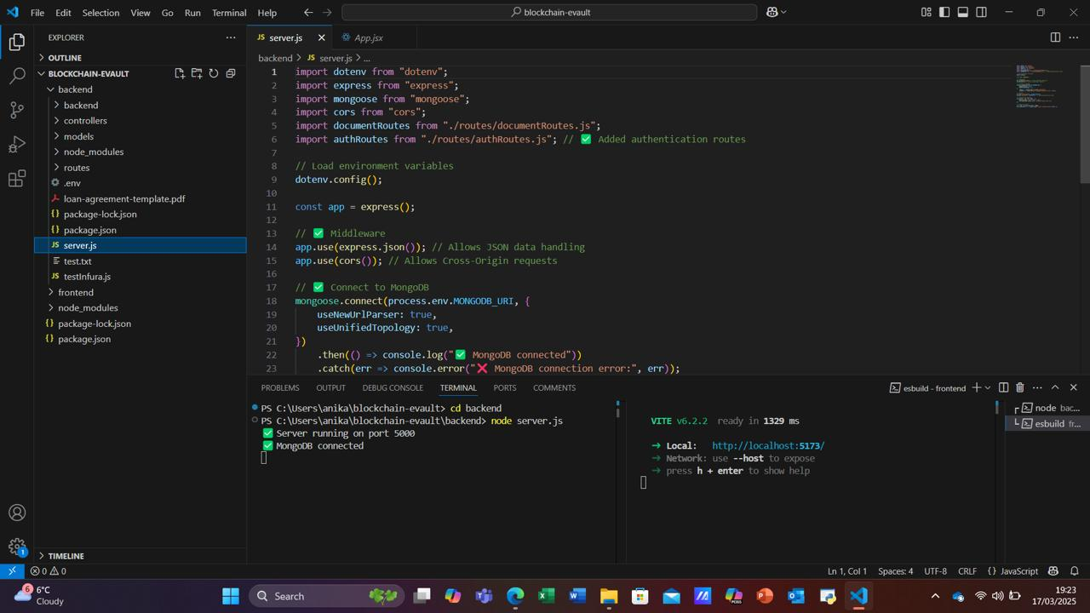
FRONTEND AND BACKEND CODE

Slide 14
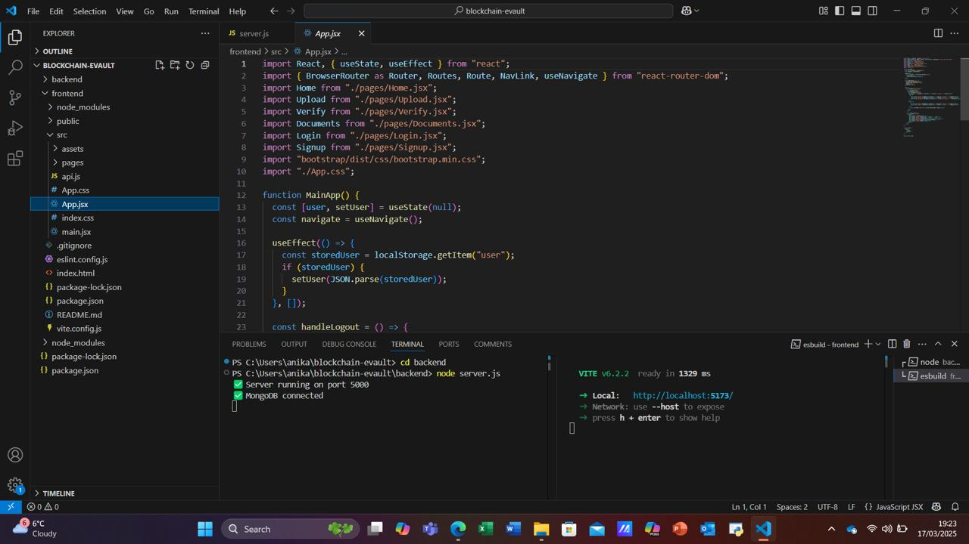

Slide 15
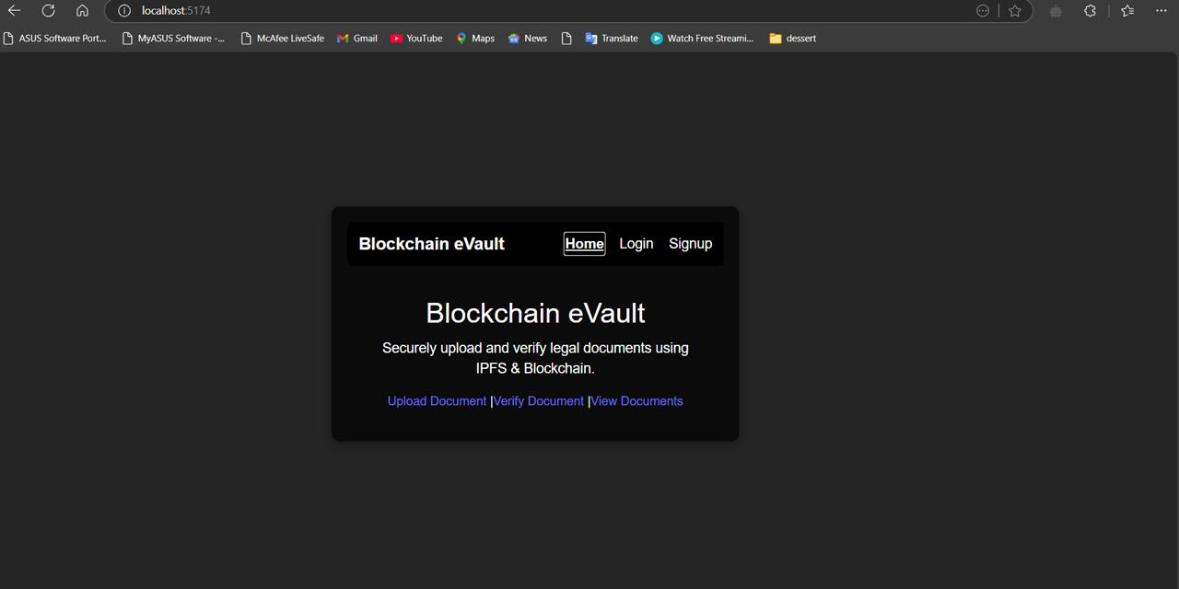

Slide 16
Conclusion
The Blockchain-Based eVault for Legal Records provides a secure, decentralized, and efficient solution for managing legal documents. By leveraging blockchain technology, smart contracts, and decentralized storage (IPFS/Filecoin), the system ensures data integrity, transparency, and security while reducing reliance on traditional centralized databases.
This approach offers several advantages, including tamper-proof document storage, automated legal verification, enhanced privacy, and cost-effective legal record management. The implementation of smart contracts eliminates the need for intermediaries, while decentralized storage prevents single points of failure.
Despite challenges such as scalability and regulatory compliance, this system has the potential to revolutionize the legal industry by improving the efficiency, security, and accessibility of legal records. Future developments could include integration with government systems, AI-powered legal analysis, and wider adoption across legal and corporate sectors.

Slide 17
References
https://www.jetir.org/papers/JETIR2406864.pdf
https://www.mdpi.com/2073-431X/10/11/135
https://www.researchgate.net/publication/329489346_CRAB_Blockchain_Based_Criminal_Record_Management_System?utm_source=chatgpt.com
https://ieeexplore.ieee.org/stamp/stamp.jsp?arnumber=10026822
https://appliednetsci.springeropen.com/articles/10.1007/s41109-020-00256-4
https://www.researchgate.net/publication/221103834_Secure_data_deduplication
https://www.mdpi.com/1911-8074/16/8/360
https://www.researchgate.net/publication/351395864_Blockchain_Law_A_New_Beginning
https://armaedfoundation.org/wp-content/uploads/2021/06/AIEF-Research-Paper-Blockchain-Technology-Recordkeeping.pdf
https://www.sciencedirect.com/science/article/pii/S0167404820302832

Slide 18
Thank You

